Slide 1

Mastering Imbalanced Data: Techniques & Evaluation
Unlocking Accurate Predictions in Real-World Scenarios

Slide 2

The Imbalance Challenge in Machine Learning
In many real-world datasets, the distribution of classes is uneven. One class, the "minority class," has significantly fewer examples than the "majority class."
This imbalance poses a significant challenge for machine learning models:
Models often become biased towards the majority class.
They perform poorly on the minority class, which is frequently the class of greatest interest (e.g., fraud detection, disease diagnosis).
Traditional accuracy metrics can be misleading, as a model might achieve high overall accuracy by simply predicting the majority class for all instances.
Addressing data imbalance is crucial for building robust and fair predictive systems.

Slide 3




SMOTE: Synthesizing Solutions for Imbalance
The Synthetic Minority Over-sampling Technique (SMOTE) is a widely used approach to address imbalanced datasets by generating synthetic samples for the minority class.
How it Works
Why it's Effective
SMOTE selects a minority class sample and finds its k-nearest neighbors. Synthetic samples are then created along the line segments connecting the sample to its neighbors.
It increases the number of minority class samples, helping the model learn more effectively from these critical cases without simply duplicating existing data points.
Balancing Act
This technique helps balance the dataset, preventing the model from overlooking the minority class and improving its predictive power on rare events.

Slide 4


Advanced SMOTE Variants: Targeting Specific Challenges
Cluster-Based SMOTE
SVM-SMOTE
Standard SMOTE can sometimes generate synthetic samples that fall outside the true distribution of the minority class, especially if the minority class forms multiple clusters.
Not all minority samples are equally important. Samples near the decision boundary are often more critical for classification than those deep within the class region.
Cluster-Based SMOTE first clusters the minority class data. Then, it applies SMOTE within each cluster, ensuring that synthetic samples are generated only within the boundaries of existing, well-defined minority class groups.
SVM-SMOTE uses a Support Vector Machine (SVM) classifier to identify the "support vectors" of the minority class. Synthetic samples are then generated only from these support vectors, which are the instances closest to the decision boundary.
Benefit: Generates more meaningful and realistic synthetic samples, reducing noise and improving classification boundaries.
Benefit: Focuses oversampling on the most informative minority instances, leading to better-defined and less ambiguous decision boundaries.

Slide 5
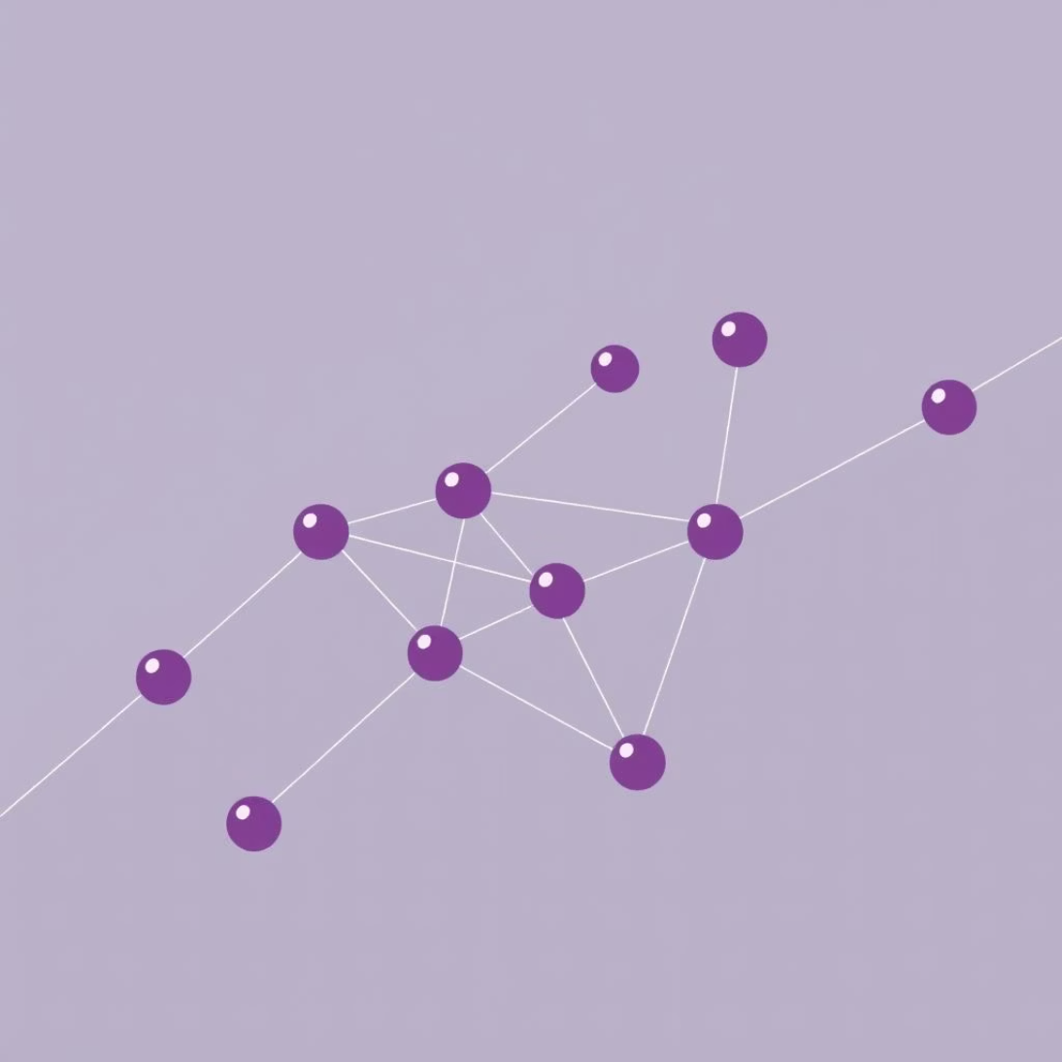

Refining SMOTE: Undersampling & Adaptive Approaches
Tomek Links SMOTE
ADASYN SMOTE
While SMOTE creates new minority samples, it can sometimes lead to overlapping between majority and minority classes, making the decision boundary harder to define.
Standard SMOTE generates synthetic samples uniformly. However, some minority instances are harder to learn from because they are in sparse regions or close to the majority class.
Tomek Links SMOTE is a hybrid approach. After SMOTE oversampling, it applies an undersampling step using Tomek Links. A Tomek Link is a pair of instances from different classes that are each other's nearest neighbor.
ADASYN (Adaptive Synthetic Sampling) adaptively shifts the decision boundary. It generates more synthetic data for minority instances that are harder to learn (i.e., those with more majority class neighbors) and fewer for easier ones.
Benefit: Removes noisy or borderline majority class samples that are very close to minority class samples, cleaning the decision boundary and improving model performance.
Benefit: Focuses data generation on challenging minority examples, leading to a more robust and adaptive learning process, especially for complex datasets.

Slide 6
Algorithm-Level Techniques: Modifying the Learning Process
Class Imbalance Penalization
Cost-Sensitive Learning
This technique directly modifies the loss function of the learning algorithm to penalize misclassifications of the minority class more heavily than the majority class.
An extension of penalization, cost-sensitive learning explicitly incorporates a cost matrix into the training process.
By assigning different misclassification costs, the model is encouraged to pay more attention to the minority class during training.
This matrix defines the penalty for each type of misclassification (e.g., false positives vs. false negatives). The algorithm then aims to minimize the total misclassification cost rather than just the number of errors.
Examples: Weighted Support Vector Machines, Weighted Logistic Regression.
Benefit: Allows for fine-grained control over the importance of different error types, crucial in high-stakes applications.

Slide 7


Ensemble Methods: Collective Intelligence for Imbalance
Ensemble methods combine multiple base learners to improve overall predictive performance. For imbalanced data, specialized ensemble techniques help address the class disparity.
Balanced Random Forest
Beyond Standard Forests
A variation of the traditional Random Forest, designed for imbalanced datasets. It addresses imbalance at the tree-building stage.
Unlike standard Random Forests which might still struggle if the imbalance is severe, the balanced approach ensures that each tree gets a fair representation of both classes during its individual training process.
How it Works: Each tree in the forest is trained on a bootstrap sample where the minority class is oversampled (or the majority class is undersampled) to create a more balanced subset.
Impact: This leads to a more robust ensemble that generalizes better across both majority and minority classes.
Benefit: Reduces bias towards the majority class without losing much information from the majority class, leading to improved performance on the minority class.

Slide 8
Sequential Ensemble Strategies for Imbalanced Data
EasyEnsemble
This method involves creating multiple balanced subsets of the training data. From the majority class, several random subsets are drawn, each combined with all minority class samples.
A base classifier is trained on each of these balanced subsets. The predictions from all base classifiers are then combined (e.g., by averaging or voting) to make the final prediction.
Key Idea: Undersampling the majority class multiple times to create diverse training sets.
1
2
BalanceCascade
BalanceCascade is an iterative ensemble technique that uses a cascading approach to undersample the majority class.
It trains multiple base classifiers sequentially. In each iteration, a subset of the majority class that was correctly classified by the previous base classifiers is removed from the training set, focusing subsequent classifiers on harder-to-classify examples.
Key Idea: Progressively "pruning" the majority class to balance the dataset while retaining challenging instances.

Slide 9
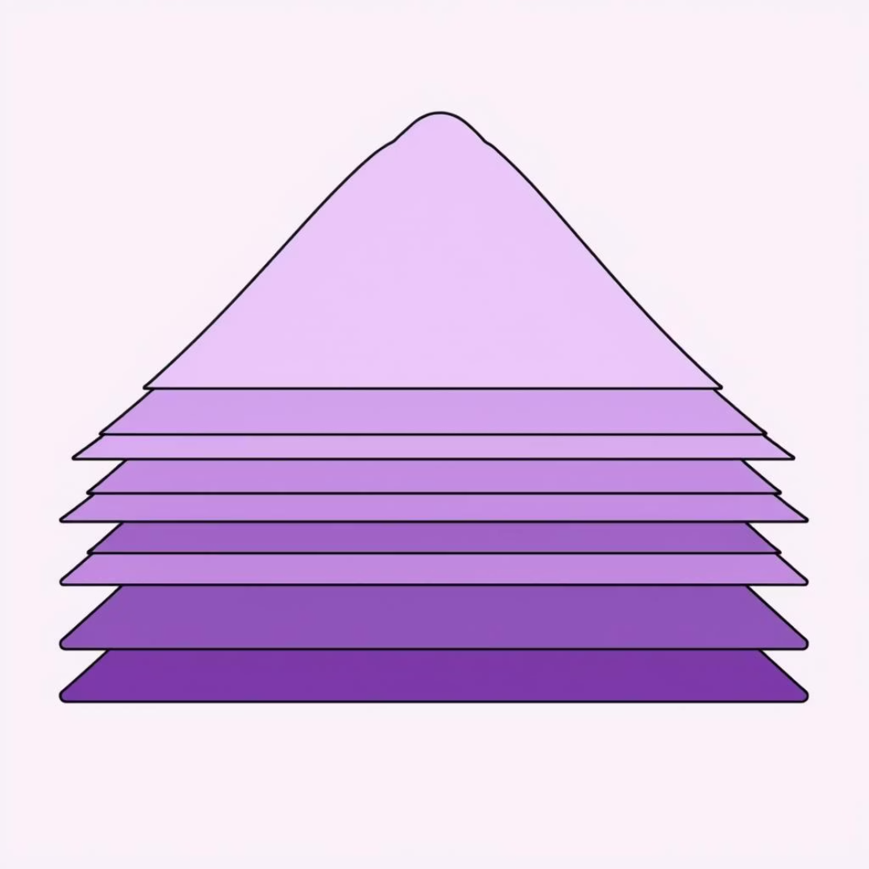
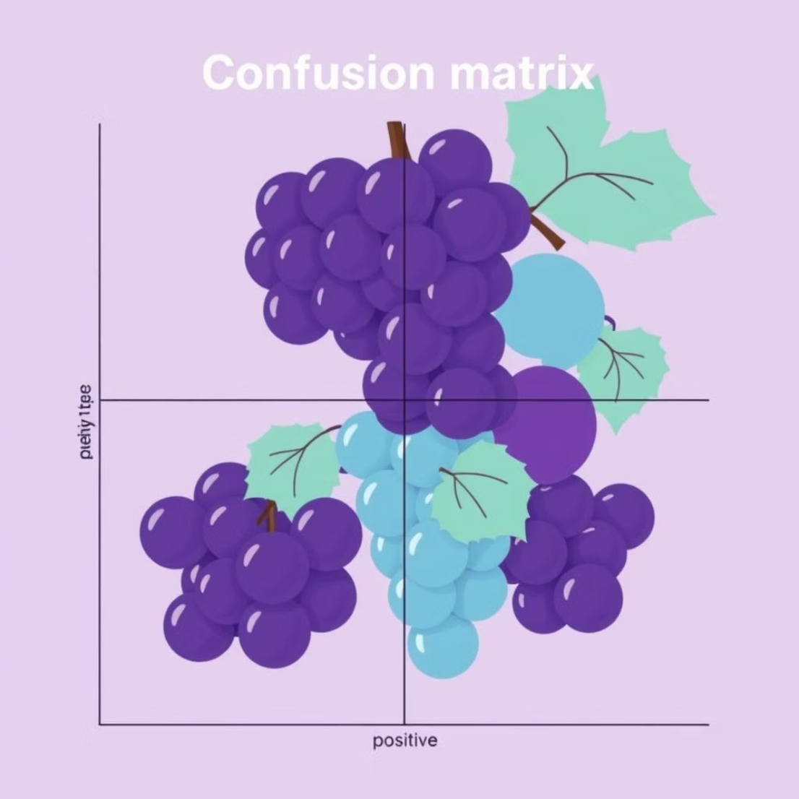
Robust Evaluation: Beyond Simple Accuracy
Stratified Cross-Validation
Confusion Matrix Analysis
In standard cross-validation, data is split randomly, which can lead to folds with highly skewed class distributions, especially in imbalanced datasets.
A confusion matrix is a table that summarizes the performance of a classification algorithm. It breaks down predictions into four categories:
Stratified Cross-Validation ensures that each fold (training and validation set) maintains approximately the same proportion of samples from each class as the original dataset.
True Positives (TP): Correctly predicted positive class.
True Negatives (TN): Correctly predicted negative class.
Benefit: Provides a more reliable and less biased estimate of model performance on both majority and minority classes across different data partitions.
False Positives (FP): Incorrectly predicted positive (Type I error).
False Negatives (FN): Incorrectly predicted negative (Type II error).
Why it Matters: Provides a detailed breakdown of errors, allowing for calculation of key metrics like Precision, Recall, F1-score, and Specificity, which are crucial for imbalanced data.

Slide 10
Optimizing Performance: Threshold Tuning & Key Takeaways
Threshold Tuning
Key Takeaways
Many classification models output probabilities rather than hard class labels. A decision threshold (typically 0.5) is then used to convert these probabilities into classes.
Imbalanced data requires specialized techniques for accurate modeling.
SMOTE and its variants synthesize new minority samples.
For imbalanced datasets, adjusting this threshold can significantly impact the trade-off between False Positives and False Negatives. Lowering the threshold might increase recall for the minority class at the expense of precision, or vice-versa.
Algorithm-level approaches (penalization, cost-sensitive) modify model learning.
Ensemble methods (Balanced RF, EasyEnsemble, BalanceCascade) leverage multiple models.
Strategy: Use ROC curves or Precision-Recall curves to find an optimal threshold that balances the costs of different error types for your specific problem.
Evaluation must go beyond accuracy: use stratified CV, confusion matrices, and threshold tuning.
Goal: Build robust, fair, and effective machine learning models even in challenging imbalanced environments.

